Slide 1
SOFTWARE TESTING
CH03: Static Testing
Course Instructor: AMIR IMAM

Slide 2
Syllabus / Outline
Static Testing
Static Analysis
Control flow
Data Flow
Static Analysis by tools
Reviews
Formal
Informal
Inspections
Walkthroughs

Slide 3
Test Design Techniques
Test Design Techniques
Static
Dynamic
Structured Based
Experienced Based
Specification Based
Reviews
Static Testing
Informal
Inspection
Technical
Walkthroughs
Static Analysis
Control Flow
Data Flow
Statement
Branch/Decision
Condition
Error Guessing
Exploratory
BVA
ECP
State Transition
Use Case
Decision Table

Slide 4
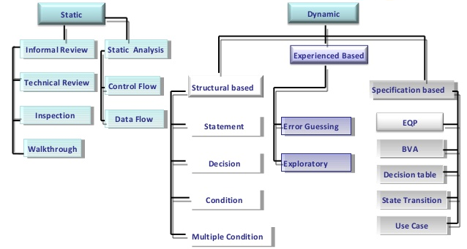
Test Design Techniques

Slide 5
What is a static test technique?
Static testing is the testing of the software work products manually, or with a set of tools, but they are not executed.
It starts early in the Life cycle.
Because of Static testing those errors uncover which are unable to find in dynamic testing.
It does not need computer as the testing of program is done without executing the program. For example: Reviewing, Walk through, Inspection, etc.

Slide 6
Work Products that Can Be Examined by Static Testing
Specifications (SRS, FS, and Security Requirements etc)
Epics, User stories, and Acceptance criteria
Architecture and Design Specifications
Code
Testware (Test plans, Test Cases, Test Procedures, and Automated Test Scripts)
User guides
Web pages
Contracts, Project Plans, Schedules, and Budgets

Slide 7
Static Testing – Identified Issues
Requirement defects (e.g., inconsistencies, ambiguities, contradictions, omissions, inaccuracies, and redundancies)
Design defects (e.g., inefficient algorithms or database structures, high coupling, low cohesion)
Coding defects (e.g., variables with undefined values, variables that are declared but never used, unreachable code, duplicate code)
Deviations from standards (e.g., lack of adherence to coding standards)
Incorrect interface specifications (e.g., different units of measurement used by the calling system than by the called system)
Security vulnerabilities (e.g., susceptibility to buffer overflows)
Gaps or inaccuracies in test basis traceability or coverage (e.g., missing tests for an acceptance criterion)

Slide 8
Static Testing - BENEFITS
Issues identified during static testing are:
Detecting and correcting defects more efficiently, and prior to dynamic test execution
Identifying defects which are not easily found by dynamic testing
Preventing defects in design or coding by uncovering inconsistencies, ambiguities, contradictions, omissions, inaccuracies, and redundancies in requirements
Increasing development productivity (e.g., due to improved design, more maintainable code)
Reducing development and Testing cost and time.
Reducing total cost of quality over the software’s lifetime, due to fewer failures later in the lifecycle or after delivery into operation.
Improving communication between team members in the course of participating in reviews

Slide 9
Review Process
The review process comprises the following main activities
Planning
Initiate Review
Individual Review (i.e., individual preparation)
Issue Communication and Analysis
Fixing and Reporting

Slide 10
Review Process
1. Planning:
Defining the scope, purpose of the review, what documents or parts of documents to review, and the quality characteristics to be evaluated.
Estimating effort and timeframe.
Identifying review characteristics such as the review type with roles, activities, and checklists.
Selecting the people to participate in the review and allocating roles.
Defining the entry and exit criteria (for formal review types).
Checking that entry criteria are met (for formal review types)

Slide 11
Review Process
2. Initiate Review
Distributing the work product (physically or by electronic means) and other material, such as issue log forms, checklists, and related work products.
Explaining the Scope, Objectives, Process, Roles, and Work products to the participants
Answering any questions that participants may have about the review.
Accepting the work product when the exit criteria are reached.

Slide 12
Review Process
3. Individual Review (i.e., individual preparation)
Reviewing all or part of the work product
Noting potential defects, recommendations, and questions
4. Issue Communication and Analysis
Communicating identified potential defects (e.g., in a review meeting)
Analyzing potential defects, assigning ownership and status to them
Evaluating and documenting quality characteristics.
Evaluating the review findings against the exit criteria to make a review decision (reject; major changes needed; accept, possibly with minor changes)

Slide 13
Review Process
5. Fixing and Reporting
Creating defect reports for those findings that require changes
Fixing defects found (typically done by the author) in the work product reviewed
Communicating defects to the appropriate person.
Recording updated status of defects.
Gathering metrics (for more formal review types).
Checking that exit criteria are met (for more formal review types).
Accepting the work product when the exit criteria are reached.

Slide 14
Roles and responsibilities involved during a review?
Moderator
Leader
Author
Reviewers
Scribe
Manager

Slide 15
Roles and responsibilities in a formal review
Author
Creates the work product under review.
Fixes defects in the work product under review (if necessary)
Management
Is responsible for review planning
Decides on the execution of reviews
Assigns staff, budget, and time
Monitors ongoing cost-effectiveness
Executes control decisions in the event of inadequate outcomes
Facilitator/Moderator
Ensures effective running of review meetings (when held)
Mediates, if necessary, between the various points of view
Is often the person upon whom the success of the review depends

Slide 16
Roles and responsibilities in a formal review
Review leader
Takes overall responsibility for the review
Decides who will be involved and organizes when and where it will take place
Reviewers
May be subject matter experts, persons working on the project, stakeholders with an interest in the work product, and/or individuals with specific technical or business backgrounds
Identify potential defects in the work product under review
May represent different perspectives (e.g., tester, programmer, user, operator, business analyst, usability expert, etc.)
Scribe (or recorder)
Collates potential defects found during the individual review activity
Records new potential defects, open points, and decisions from the review meeting (when held)

Slide 17
Review Types
Informal review (e.g., buddy check, pairing, pair review)
Walkthroughs
Technical Reviews
Formal Reviews

Slide 18
Review Types
Informal review (e.g., buddy check, pairing, pair review)
Main purpose: detecting potential defects
Possible additional purposes: generating new ideas or solutions, quickly solving minor problems
Not based on a formal (documented) process
May not involve a review meeting
May be performed by a colleague of the author (buddy check) or by more people
Results may be documented
Varies in usefulness depending on the reviewers
Use of checklist is optional
Very commonly used in Agile development

Slide 19
Review Types
Walkthrough
Main purposes: find defects, improve the software product, consider alternative implementations, evaluate conformance to standards and specifications.
Possible additional purposes: exchanging ideas about techniques or style variations, training of participants, achieving consensus
Individual preparation before the review meeting is optional
Review meeting is typically led by the author of the work product
Scribe is mandatory
Use of checklists is optional
May take the form of scenarios, dry runs, or simulations
Potential defect logs and review reports may be produced
May vary in practice from quite informal to very formal

Slide 20
Review Types
Technical review
Main purposes: gaining consensus, detecting potential defects
Possible further purposes: evaluating quality and building confidence in the work product, generating new ideas, motivating and enabling authors to improve future work products, considering alternative implementations
Reviewers should be technical peers of the author, and technical experts in the same or other disciplines
Individual preparation before the review meeting is required
Review meeting is optional, ideally led by a trained facilitator (typically not the author)
Scribe is mandatory, ideally not the author
Use of checklists is optional
Potential defect logs and review reports are typically produced

Slide 21
Review Types
Inspection
Main purposes: detecting potential defects, evaluating quality and building confidence in the work product, preventing future similar defects through author learning and root cause analysis
Possible further purposes: motivating and enabling authors to improve future work products and the software development process, achieving consensus
Follows a defined process with formal documented outputs, based on rules and checklists
Uses clearly defined roles, which are mandatory
Individual preparation before the review meeting is required
Reviewers are either peers of the author or experts in other disciplines that are relevant to the work product

Slide 22
Static Analysis?
Standard Compliance
Code Metrics
Data Flow Analysis

Slide 23
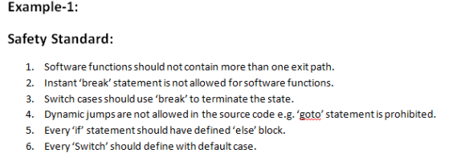
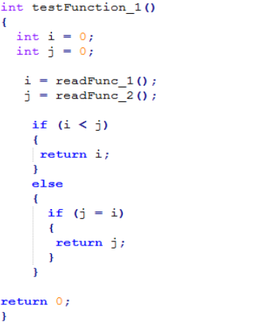
Static Analysis – STANDARD COMPLIANCE

Slide 24
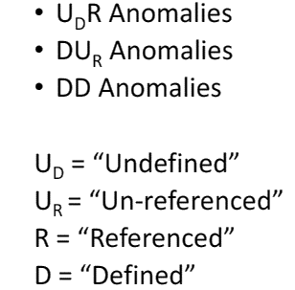
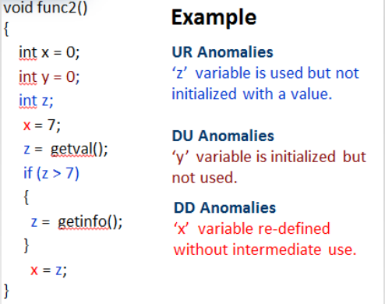
Static Analysis – DATA FLOW ANALYSIS

Slide 25
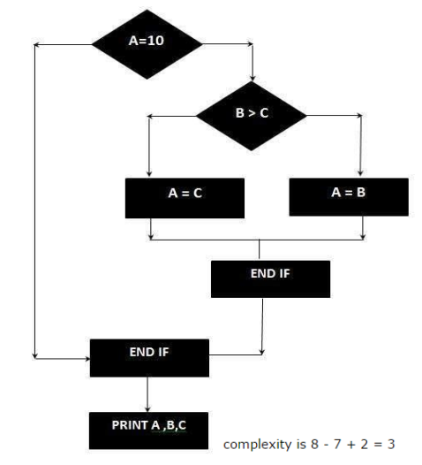
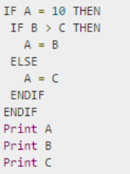
Static Analysis – CODE METRIC
Cyclomatic Code Complexity CC = E – N + 2P
E = Number of Edges N = Number of Nodes in Graph (Shapes) P = Exit Paths

Slide 26
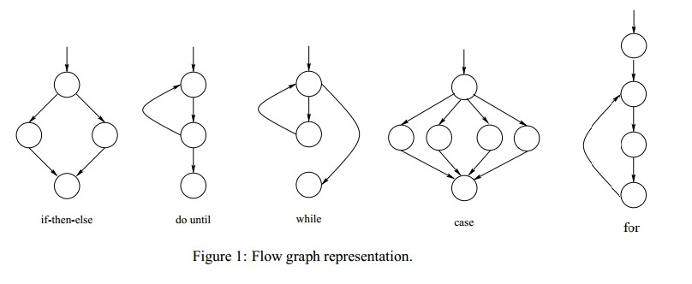
Cyclomatic Complexity

Slide 27
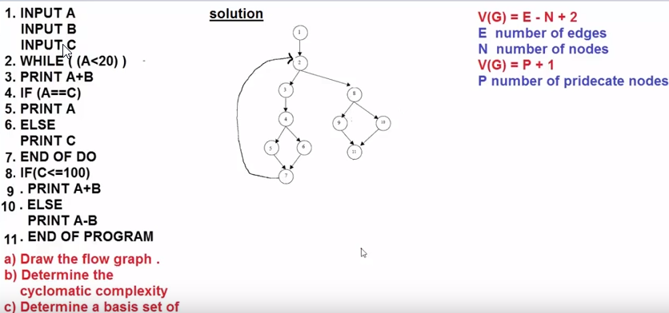
Cyclomatic Complexity
Path1: 1-2-8-9-11
Path2: 1-2-8-10-11
Path3: 1-2-3-4-5-7
Path4: 1-2-3-4-6-7

Slide 28
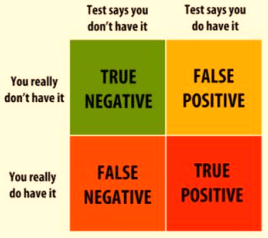
FALSE POSITIVE AND FALSE NEGATIVE
False positives: when a test case fails, but in actuality there is no bug and/or the functionality is working correctly.
False negatives: when the test case passes, but there is in fact a bug present in the system and/or the functionality is not working as it should

Slide 29
Quality Audits
“A systematic and independent examination to determine whether quality activities and related results comply with planned arrangements, and whether these arrangements are implemented effectively and are suitable to achieve objectives“
GOAL: To collect objective evidence to permit an informed judgment about the status of the systems or product being audited

Slide 30
Basic Types of Quality Audits
Internal (First Party, Self): This type includes audits by company employees, consultants and contractors to its own company.
External (Second Party, Third Party):
Supplier Audit (Second Party):
Customer employee(s) audit your company or
Your employee(s) audit a company which supplies your company with a product or service
Independent Organization(Third Party Audit)
A customer wants an audit of your company

Slide 31
Audit Sub-Types
Compliance (do we comply with the standard)
Example: Desk audit of high level systems
System (the theory)
Example: Audit of Document Control
Process (the practice)
Example: Audit of any process (manufacturing)
Product (the result)
Example: Audit of finished products to fulfill technical specifications

Slide 32
Who Perform an Audit
(A) Imposed Upon Manufacturer and Supplier
Regulatory
Customer or Potential Customer
Third Party on Behalf of Customer

Slide 33
Who Perform an Audit
(B) Performed by Manufacturer
(i) Internal Self Inspection
(ii) External

Slide 34
Reason of Quality Audit
INTERNAL:
in order to
Determine the level of compliance
Build confidence (hopefully) in the QA system
Build interdepartmental trust, understanding, and communication
Determine measures necessary to improve, e.g.,:
Premises, equipment, environment
Operations, actions, procedures
Personnel/training
Provide a stimulus for improvement
Recommend corrective action (CAPA)
Monitor improvement

Slide 35
Reason of Quality Audit
EXTERNAL:
in order to
Establish and monitor capability of supplier or contractor to deliver Goods and services that are fit for purpose (and on time, and in the quantity required)
Build mutual confidence.
Promote understanding and communication between the parties involved
And in general, as listed for “internal”

Slide 36
Quality Audits Steps
Plan and Prepare
Arrange and Announce
Arrive at site, meet, explain purpose
Perform Audit
Informal oral reporting finding
Formal reports with recommendations
Follow-up

Slide 37
Process Audits
examination of
1. established methods
2. instructions
3. work flow for processes
4. maintenance programs for production equipment
5. material handling
6. housekeeping around the work area

Slide 38
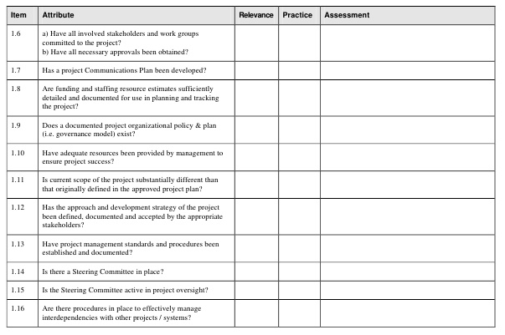
Typical Checklist for Quality Audits

Slide 39
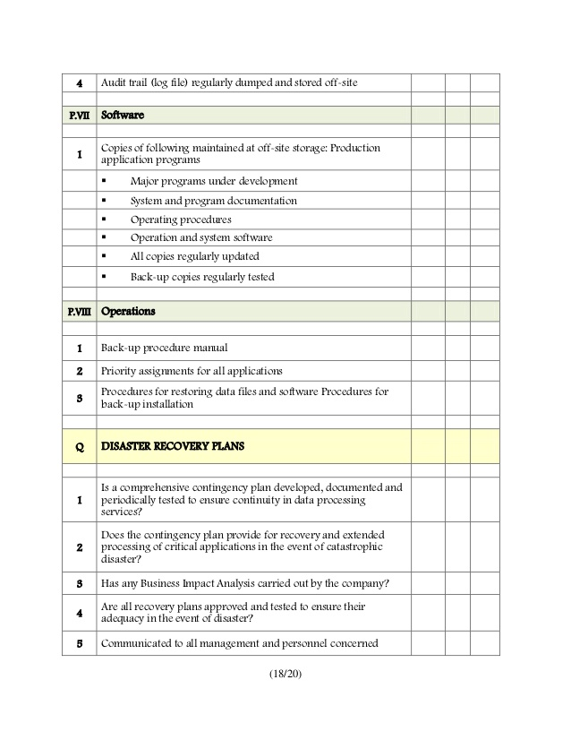
Typical Checklist for Quality Audits

Slide 40
Any Question?
End!

